Slide 1
Section 15 Inference for the Slope of a Regression Line
© Copyright all rights reserved to Homework depot: www.BCMath.ca

Slide 2
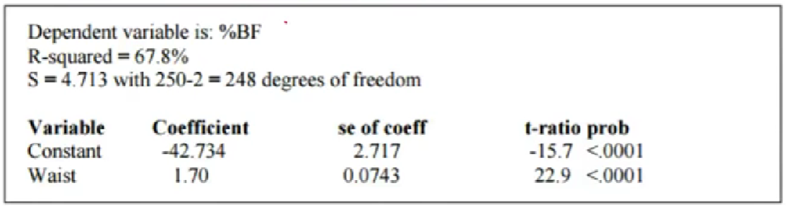
The purpose of this section is to learn to READ & analyze a computer output for AP Stats
Identify Independent Variable “X”
Dependent Variable “Y” [Predicted]
Slope and Y-intercept of LSRL
Correlation between “X” and “Y” variable
Identify the DF and sample size
Interpret the SE, “T” value, “P” value for both the constant and slope
Create a % confidence interval for the slope and “Y” intercept for the LSRL
Perform a Linear Regression Test on the slope

Slide 3
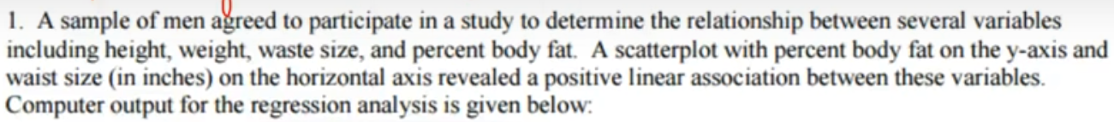

Reading a Computer Output: Identifying Variables and LSRL
“X” Variable:
Waist size in inches
LSRL:
“Y” Variable:
Predicted Body Fat Percentage
NOTE: the y-variable is a predicted value, not the actual observed value!!
1.70
For each increase of 1” in waist line, the predicted BF% increases by 1.7%
Slope LSRL:
Y-intercept LSRL:
$$−42.734$$

Slide 4
Tells you how strong the relationship is between “X” and “Y”
The “R” Squared value is for correlation between the two variables
R-Squared = 67.8%
67.8% of the variation in the BF% can be explained by Waist size using the LSRL
Coefficient correlation is equal to 0.823407. This indicates a strong positive linear relationship between waist size and Body fat %.
The Degrees of Freedom is sample size minus 2
The sample size is 250 [$n=250$]
The “S” value is the standard deviations for the residuals [observed minus predicted y-values]

Slide 5
This part can be used to create a Conf Int for the slope
SE Coeff: This is the standard Error of the sampling distribution for the SLOPE of the LSRL
Imagine you are performing a T-test for the slope of the LSRL
The NULL HYPOTHESIS would be the slope of the LSRL is equal to
ZERO!
The Alternative hypothesis would be the slope of the LSRL is NOT equal to zero
The “T” ratio or “T value” is the test statistics of your sample. How many SE your sample mean is away from the hypothesis population mean [$μ=0$]
The “P” value is the probability that you will have your “slope” given that the slope from the Null hypothesis is zero. [Conditional Probability]
If the P-value is small, it is good evidence to reject the Null that the slope is zero and accept the alternative hypothesis, where slope is not zero

Slide 6
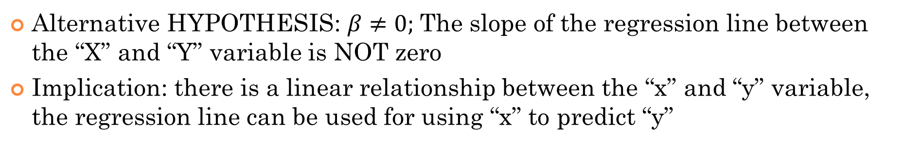
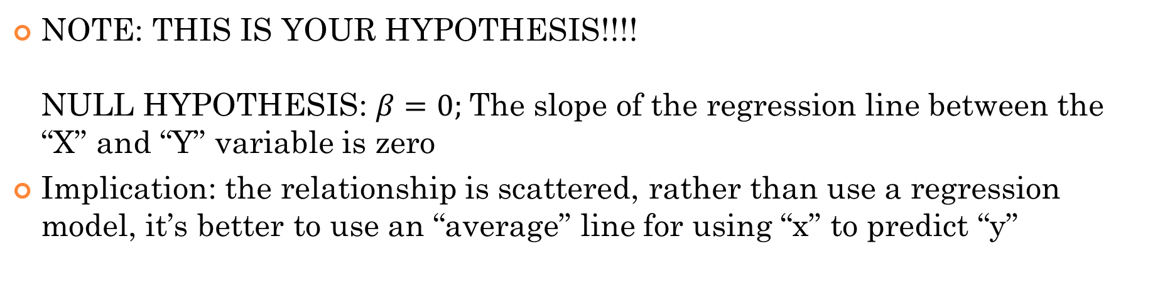
NOTE: THIS IS YOUR HYPOTHESIS!!!! NULL HYPOTHESIS: $β=0;$The slope of the regression line between the “X” and “Y” variable is zero
Implication: the relationship is scattered, rather than use a regression model, it’s better to use an “average” line for using “x” to predict “y”
Alternative HYPOTHESIS: $β≠0;$The slope of the regression line between the “X” and “Y” variable is NOT zero
Implication: there is a linear relationship between the “x” and “y” variable, the regression line can be used for using “x” to predict “y”
When the P-value of your slope is low, then that means……
Reject the NULL and accept the alternative that the slope is not zero

Slide 7
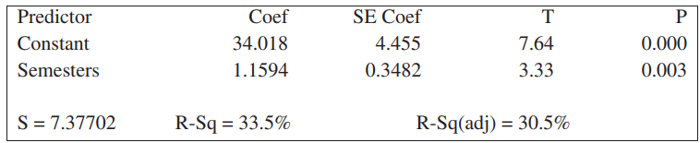
The report below is a linear regression analysis between the number of semesters required to complete an academic program in University and the starting annual salary of a corresponding job. Values are in ($1000 us)
i) Identify both the independent and dependent variables
ii) Identify and interpret the slope and y-intercept of the LSRL in context
iii) Write and interpret the LSRL in context
iv) Interpret the R2 and R value
v) Create a 95% confidence interval for both the slope and y-intercept

Slide 8
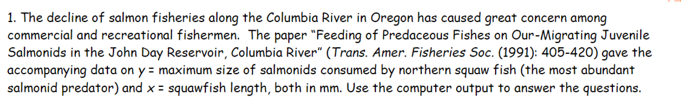
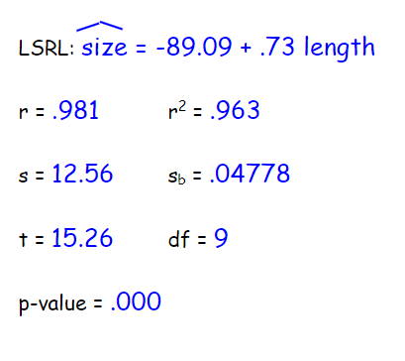
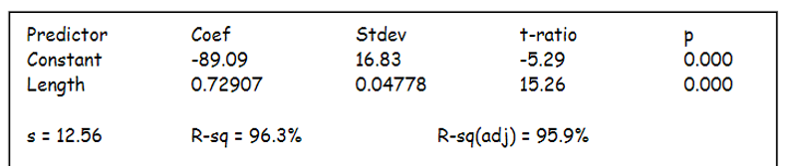

Slide 9
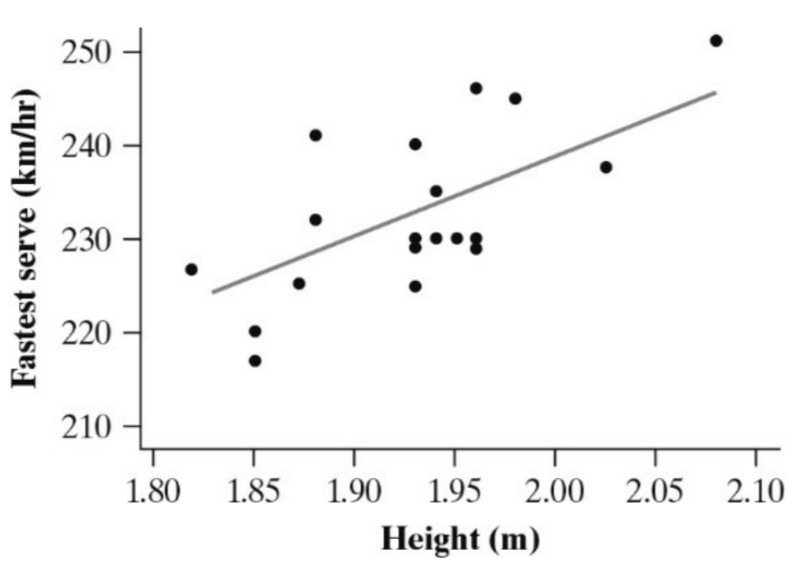
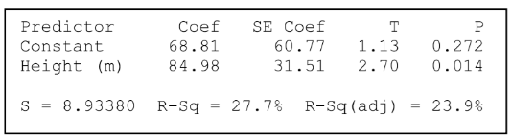
Identify both independent and dependent variables and the LSRL
Interpret the slope of the LSRL
Create a 99% confidence interval for the slope of the LSRL

Slide 10
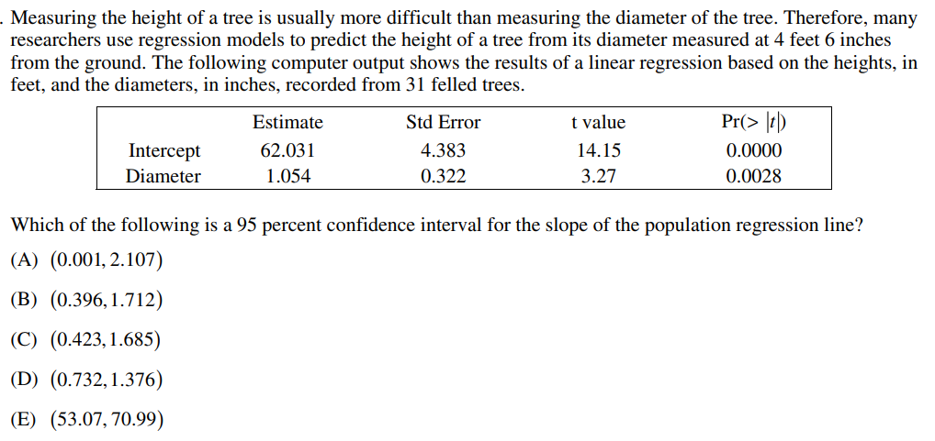

Slide 11
Inference on a Linear Regression
When constructing a LSRL based on a sample data from a scatterplot, our line is just an approximation of the TRUE population regression line
The slope and y-intercept of our LSRL is just an estimate and differs every time depending on our sample
To goal is to use inference to find the true population Slope by getting a Percentage confidence interval for it
LSRL
Confidence Interval for “B”
Standard Error for the slope “B”
NOTE: If you have a Ti84 or higher, your calculator has the G: LinRegT-Int function that gets you the confidence interval easily. If you have a Ti83, you are #$(+*#W&@$.... (+#(%)+@# ………

Slide 12
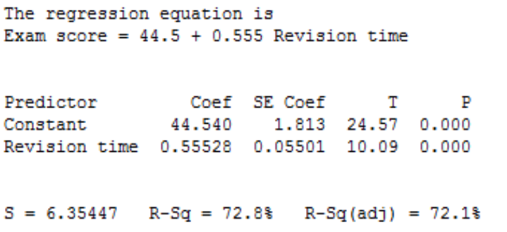
Take a moment and appreciate your Ti84, plus, Ti8000……..
So what you do you if you don’t have “LinRegTint”…… just wait….. We will get to that at the end……
Good news is that most AP questions provide a mini-output that gives you all the info required….
This is a LSRL relating the 2 variables “Exam scores”(y) and “Revision time” (x)
Suppose we want to create a 95% confidence interval for the slope “b”
We are 95% confident that the interval from (0.428146, 0.68152) captures the true slope of the regression line

Slide 13
A study reported 10 randomly selected cereals on a 100 point scale (high numbers are better) and recorded the number of grams of sugar in each serving. The data is below:
a) Find the LSRL using sugar amount (s) to predict rating score (r)
b) Construct and interpret a 95% confidence interval for the true slope of the regression line. Assume the conditions for performing inference are met

Slide 14
Hypothesis Test for Slope of LSRL
In addition to finding a confidence interval for the true slope, you can also perform a hypothesis test for the value of the slope
Null Hypothesis: There is no linear relationship between the two variables,
$β$ refers to the true population slope, where “b” is the slope of the LSRL
Ha: There is a linear relationship between the two variables
Plot the data, do a linear regression to decide if the slope is positive or negative
Using LinRegTest, you can perform a hypothesis test on the slope of the regression line
CONDITIONS: i) The sample must be a SRS
ii) The scatterplot should be approximately linear
iii) There should be no pattern in the residual plots
iv) The distribution of the residuals should be approx. normal

Slide 15
Ex: The following table gives the serving speeds in mph of 10 randomly selected professional tennis players before and after using newly developed tennis racquet.
a) Is there evidence of a straight line [linear] relationship with positive slope between serving speeds of professionals using their old and new racquets? Write the Null and Alt. Hypothesis
b) Create a scatterplot to check if the relationship is linear
c) Create a residual plot to check for overall pattern
d) Check that the distributions of the residuals is normal by creating either a histogram or normal probability plot
e) Using LinRegTest to find the “t*” and P-value
f) Interpret your results in the context of the LSRL

Slide 16
t = 5.853 P=0.0019
With such a small p value that is less than any reasonable significance level, we will reject the null hypothesis and accept the alternative that there is a positive linear relationship with the LSRL between the serving speeds of professional tennis players using NEW and OLD tennis rackets.
With a slope of approximately 1 and a y-intercept of 8.76, the regression line indicates that use of the new racquet increases serving speed on average by 8.76mph regardless of het old racquet speed. This is, players with lower and higher old racquet speeds experience on the average the same numerical increase when using the new racquet.

Slide 17
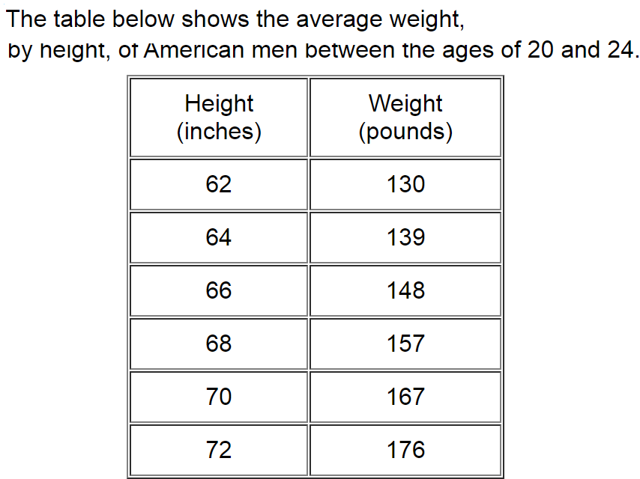
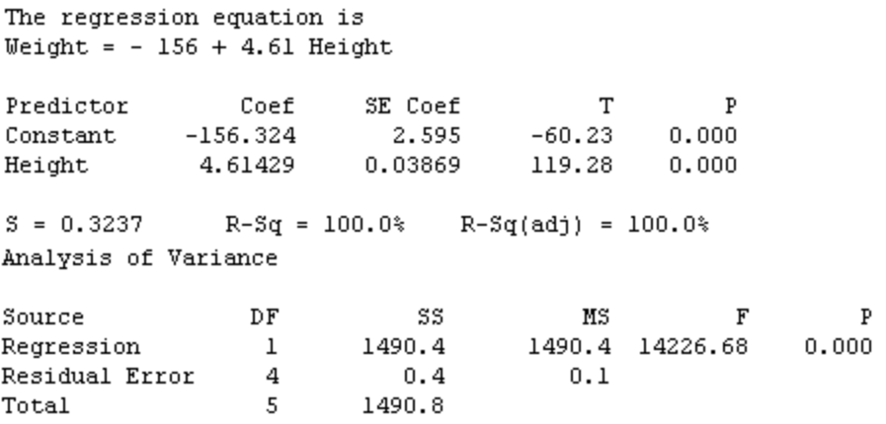
a) Is there evidence of a straight line relationship with positive slope between serving speeds of professionals using their old and new racquets?
Write the Null and Alternative hypothesis
b) Construct and interpret a 95% confidence interval for the true slope of the regression line. Assume the conditions for performing inference are met

Slide 18
IF you DON’t HAVe LINRegT-int
Option#1: Buy a Ti84 that does……
Option #2: Write down these formulas and learn to use them:
Confidence Interval for slope “b”
Standard Error for the sampling distribution of the slope
TEST Statistics
Standard deviations of the residuals

Slide 19
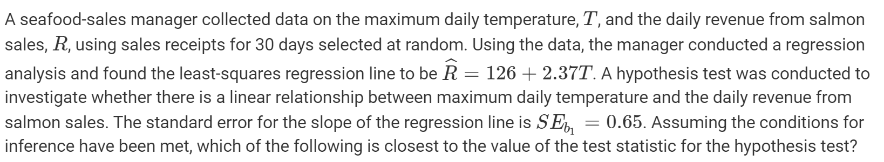
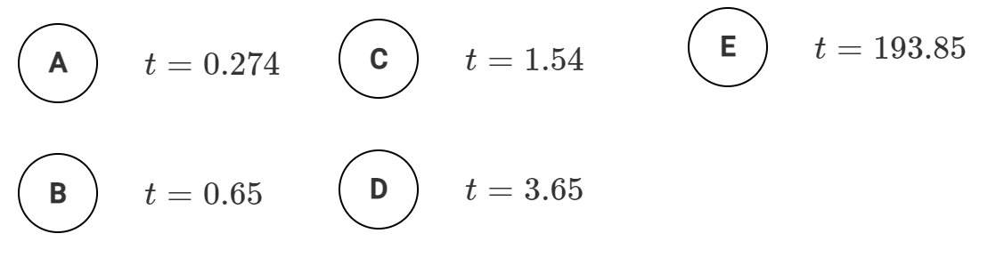


Slide 20
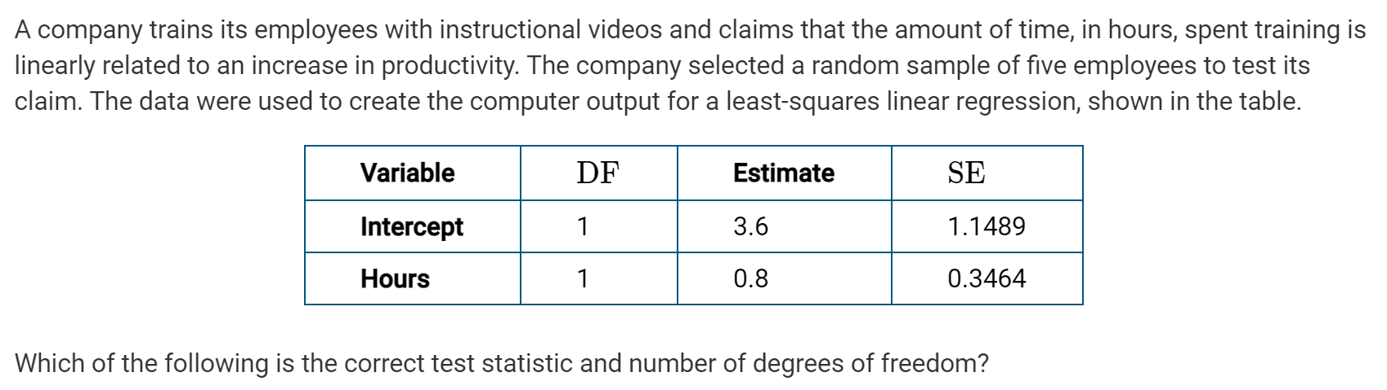
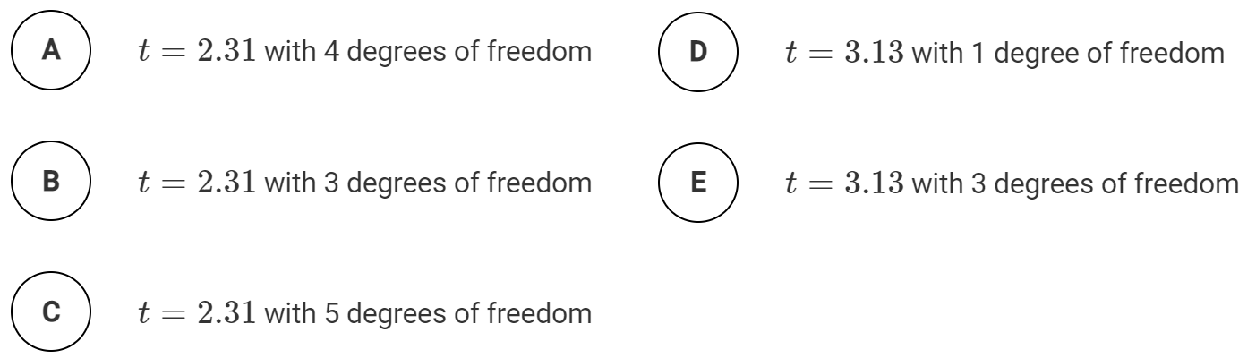
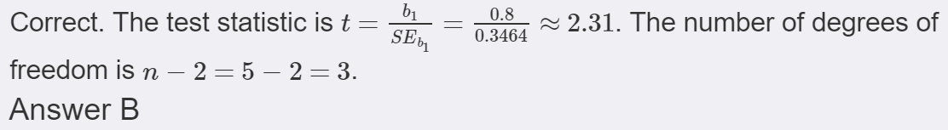

Slide 21
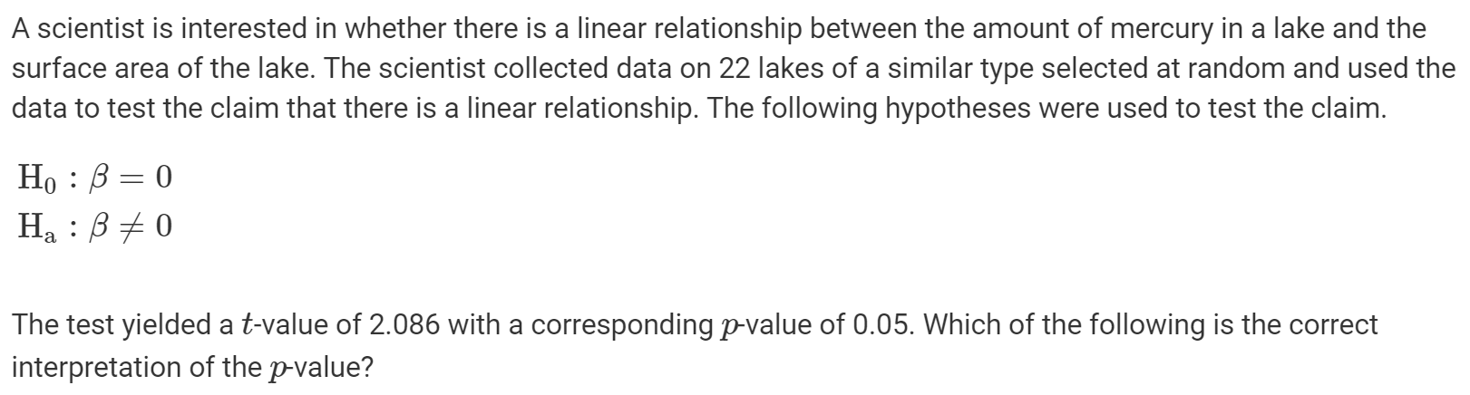
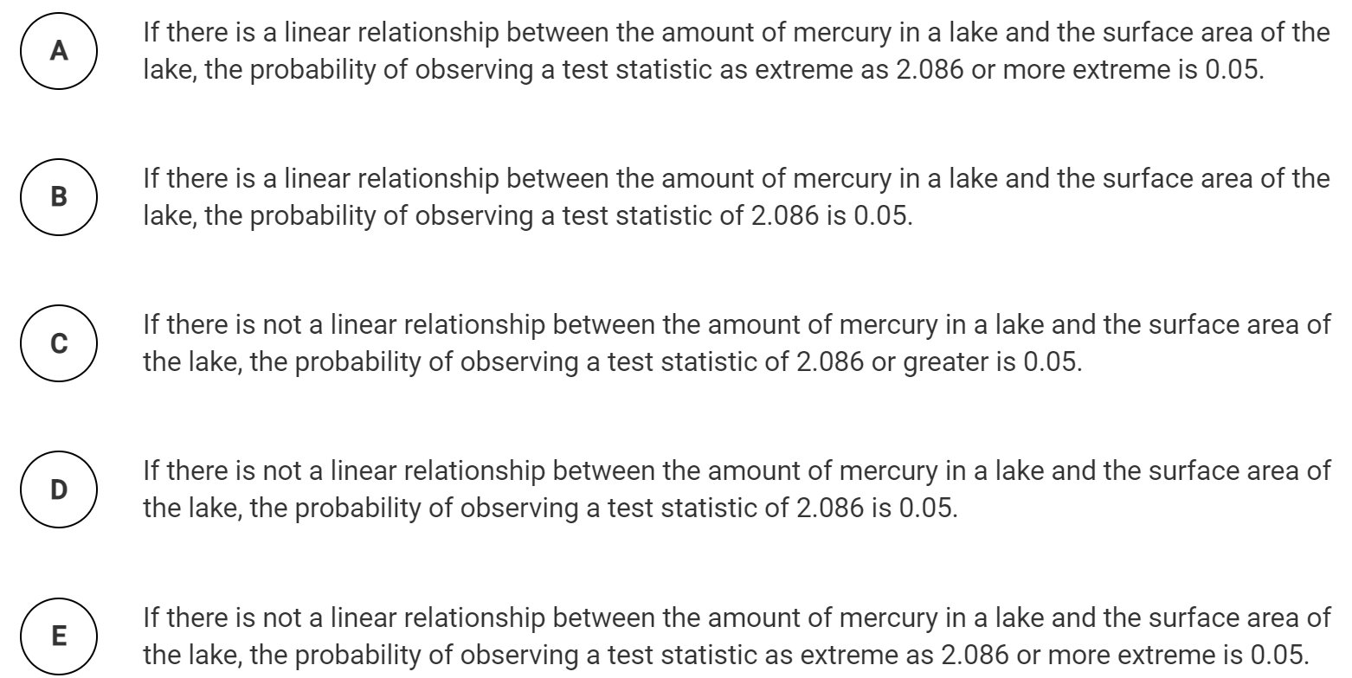

Slide 22
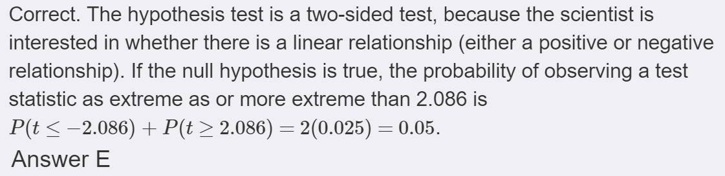

Slide 23
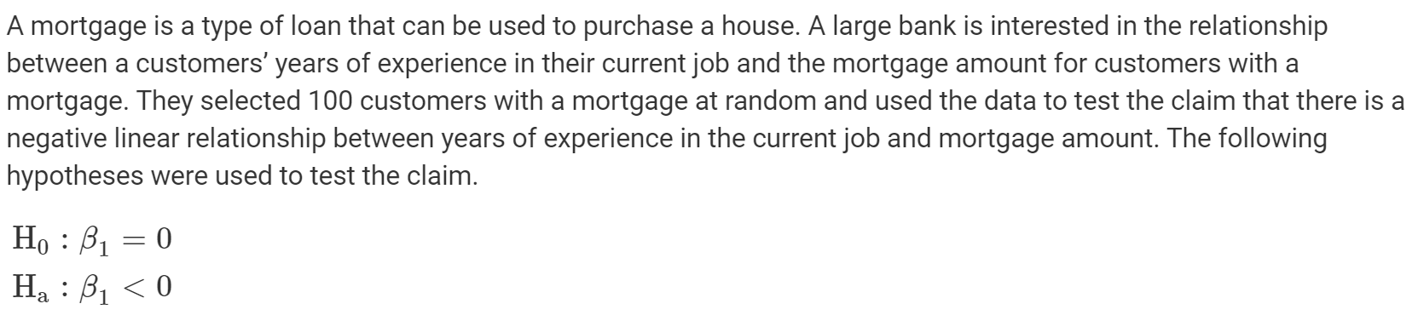
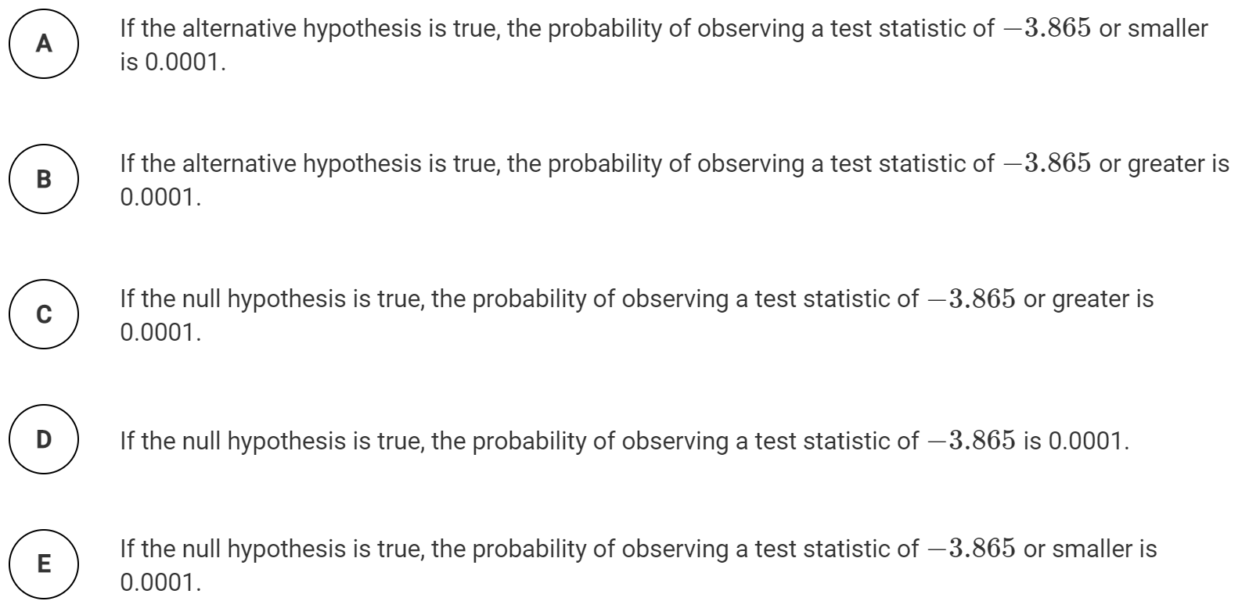

Slide 24
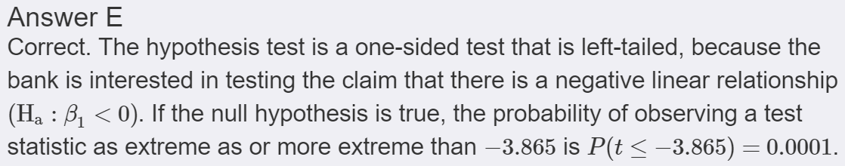

Slide 25
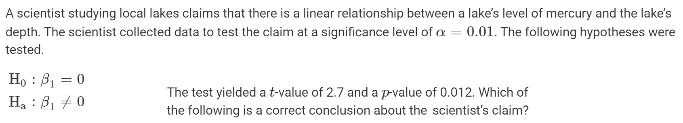
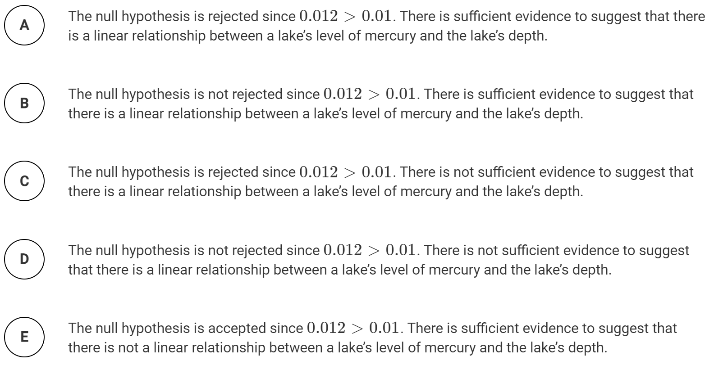

Slide 26
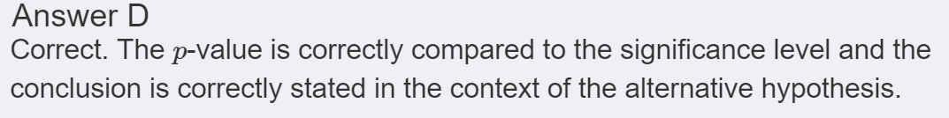

Slide 27
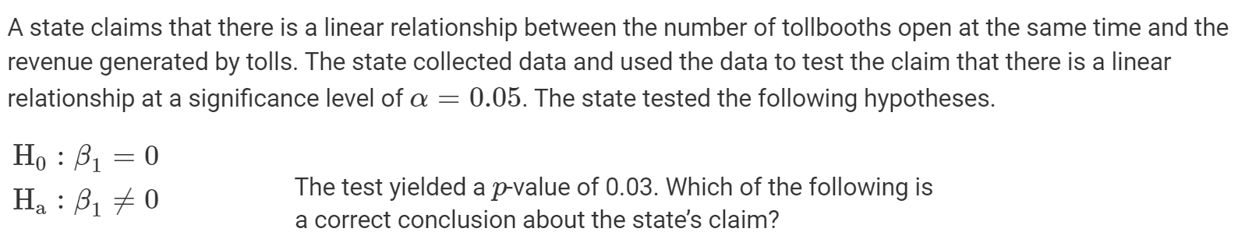
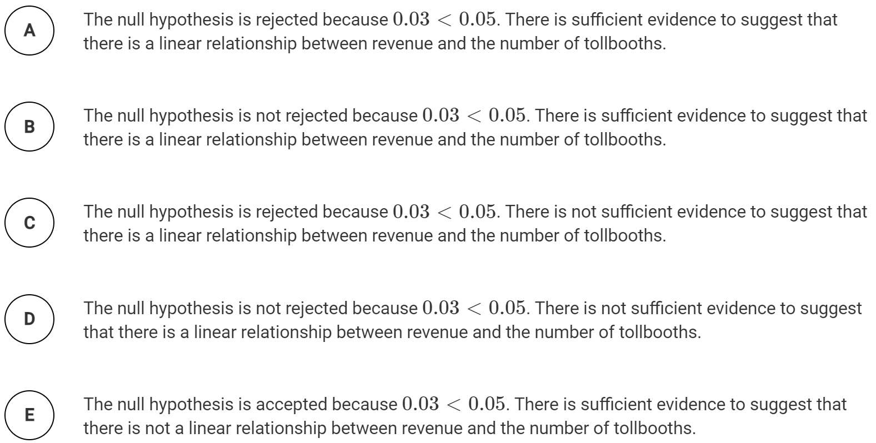

Slide 28
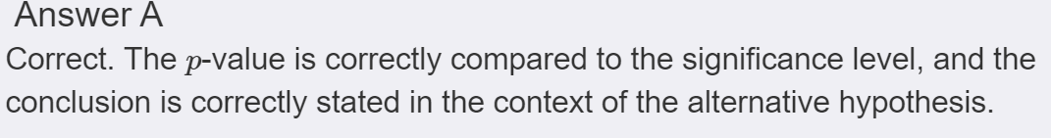

Slide 29
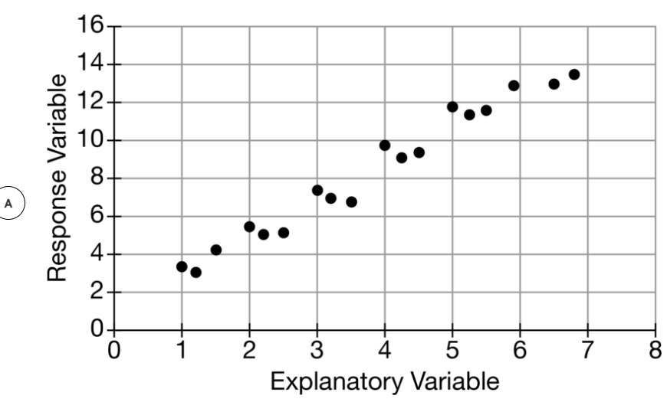
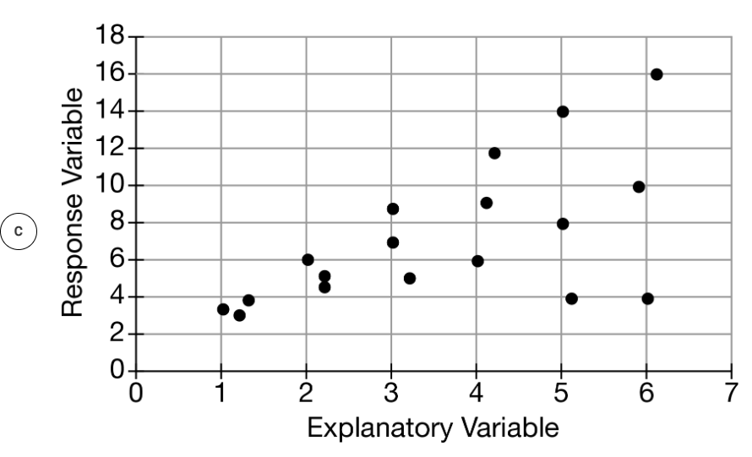
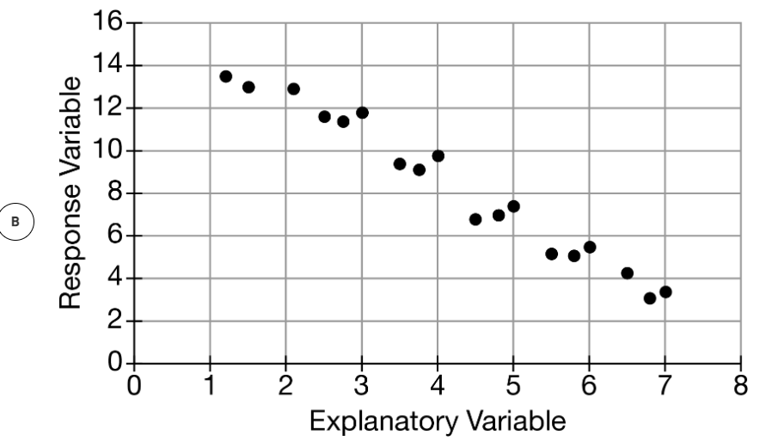
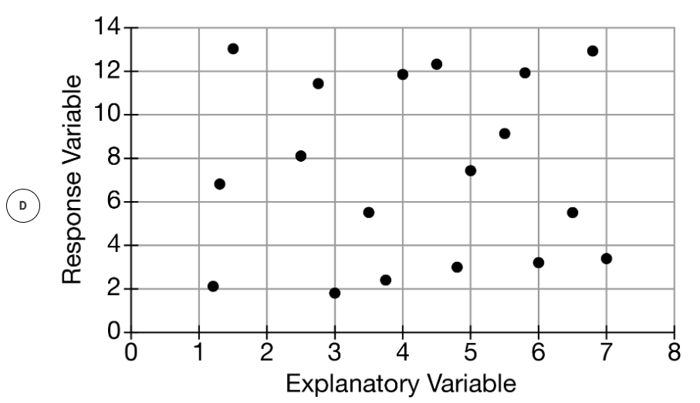
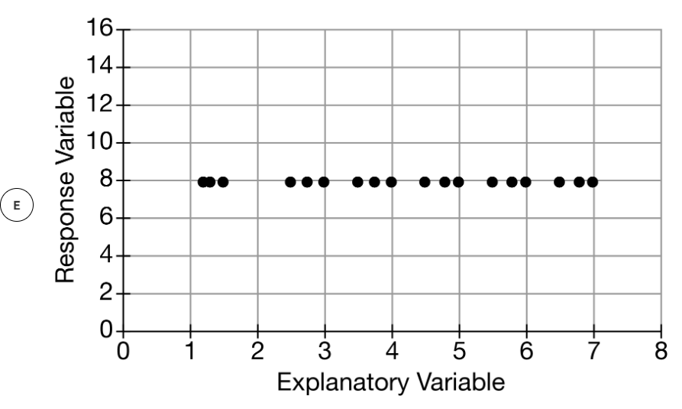

Slide 30
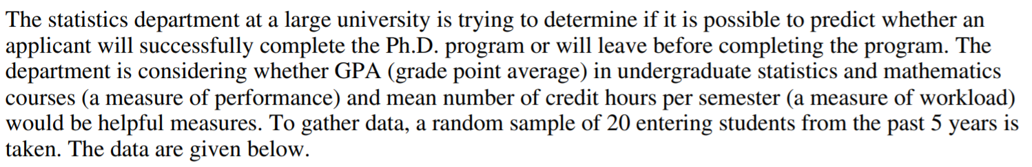
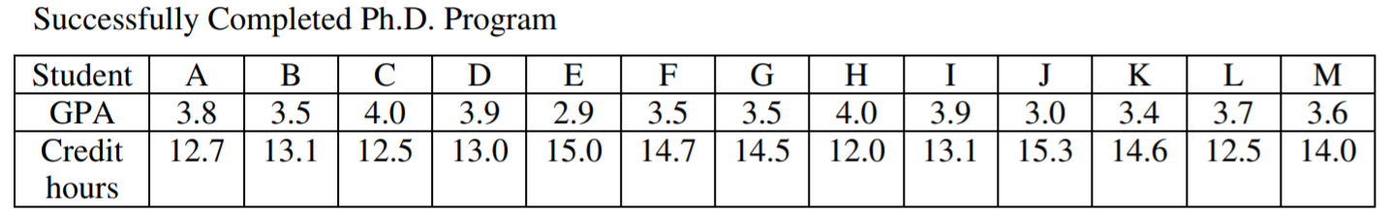
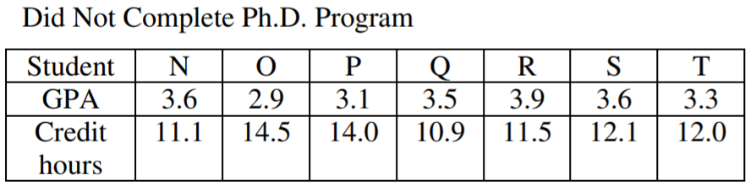
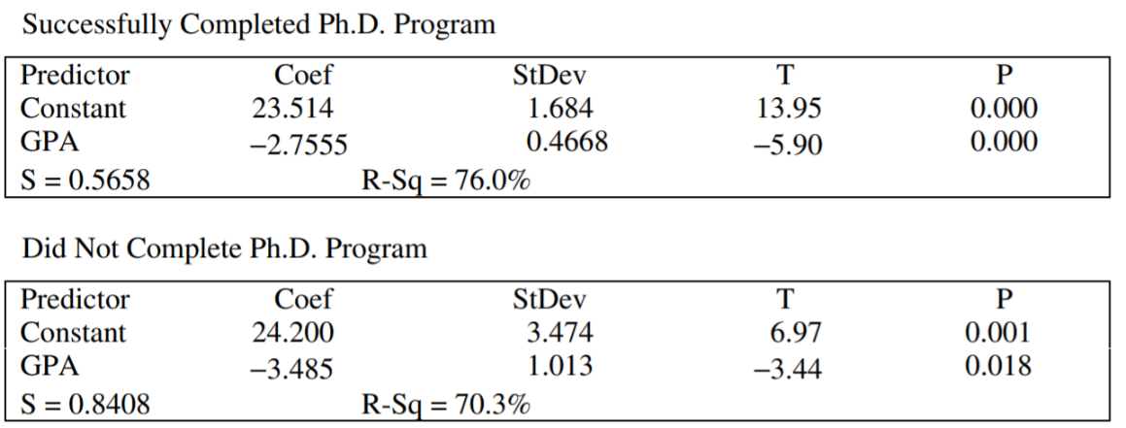
Q1: (AP 2001)

Slide 31
a) What are the variables involved and write the equations of the LSRL for both groups, students that completed their PhD and students that did not complete their PhD.
b) Indicate and interpret the slopes of both these lines:
Variables: GPA (Grade point average) and Mean Number of Credit hours per semester
Predicted Mean Credit hours = -2.7555 (GPA) + 23.514 [Students completing PhD]
For every increase in GPA by 1 point, the number of mean credit hours per semester decreases by 2.7555 hours
Predicted Mean Credit hours = -3.485 (GPA) + 24.200 [Students NOT completing PhD]
For every increase in GPA by 1 point, the number of mean credit hours per semester decreases by 3.485 hours

Slide 32
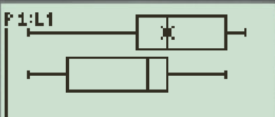
c) Use an appropriate display to compare the GPA’s for the two groups. Write a few sentences commenting on your display
Displays that are suitable for comparing the GPAs for the two groups can be a BOXPLOT
Type the GPAs for the two groups into L1 an L2 and then display your boxplots:
The top box plot is for students that completed their phD. The 5 number summary are as follow: 2.9, 3.45, 3.6, 3.9, 4. The bottom box plot is for students that did NOT complete their phD and the 5 number summary are: 2.9, 3.1 3.5, 3.6, 3.9.
The distribution of GPA for students that completed their PhD is skewed to the right. They also have a noticeable higher Q1, Median, Q3.
The distribution of GPA for students that completed their PhD is symmetrical. The Q1, Median, and Q3 are lower.
The max and min for both groups are somewhat similar.

Slide 33
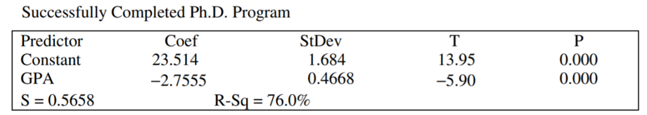
d) For students who successfully completed the Ph.D. program, is there a significant relationship between GPA and mean number of credit hours per semester? Give a statistical justification to support your response
Q: How do you show whether if there is a relationship between GPA and Mean number of credit scores?
Answer: 1. R2 value. 2. Perform a test on whether if the slope of the LSRL is zero (no relationship) or NOT zero (A relationship exist)
Ho: Slope of the LSRL is zero (No relationship between the two variables)
Ha: Slope of the LSRL is NOT zero (Relationship Exists between the two variables)
Find the test statistics for the slope
From our test statistics, it yielded a P value of 0.0000. Which indicates that we should reject Ho and accept the Alternative Hypothesis that a relationship exists between the two variables.
P – value is 0.000

Slide 34
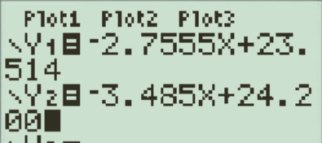
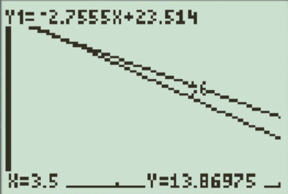
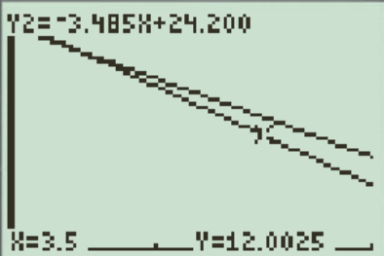
e) If a new applicant has a GPA of 3.5 and a mean number of credit hours per semester of 14.0, do you think this applicant will successfully complete the PhD program? Give a statistical justification to support your response:
Q: How do you decide which LSRL is more appropriate for the student mentioned above?
Answer: Use both LSRL to calculate the predicted mean number of credit hours per semester based on a GPA score of 3.5. Then compare which regression line has a smaller residual.

Slide 35
The LSRL line for students that completed their PhD gave a predicted mean credit hours per semester of 13.86975. This would yield a residual of 0.13025 mean credit hours per semester.
The LSRL line for students that did NOT completed their PhD gave a predicted mean credit hours per semester of 12.0025. This would yield a residual of 0.19975 mean credit hours per semester.
Since the LSRL for student that completed their PhD gave a lower residual than the regression for students that did NOT complete their phD. Therefore, it would seem that this student would be likely to complete their PhD.

Slide 36
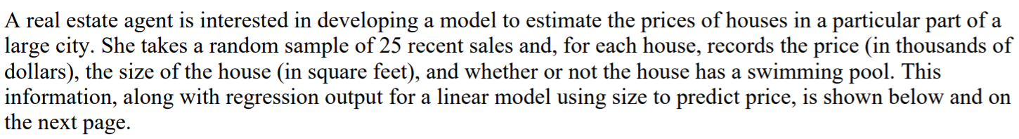
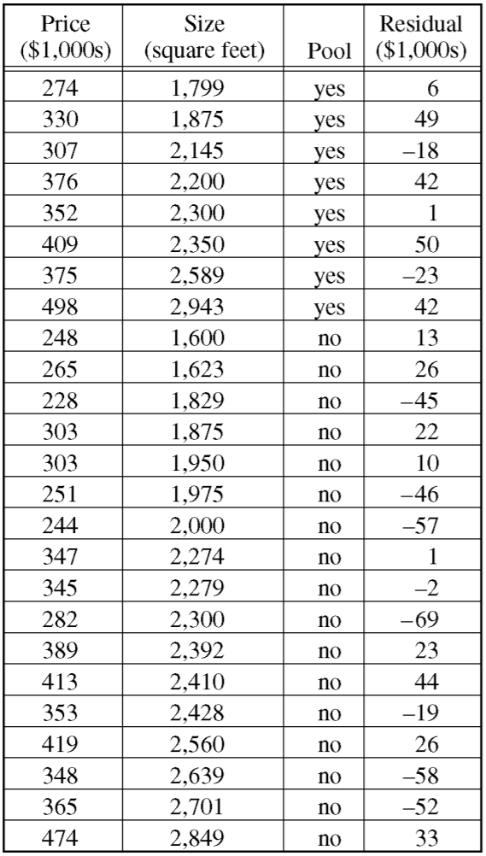
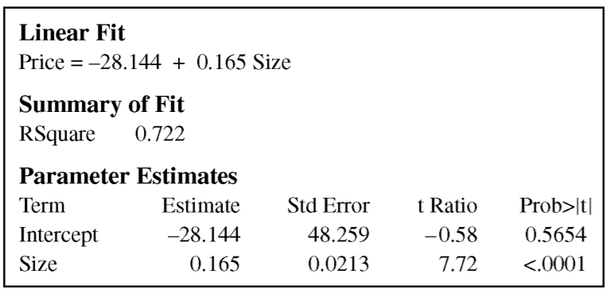
The slope of the LSRL is 0.165. For every increase in 1 sqft in the size, the value of the property will increase by 0.165 (1000s), which is $165.
A residual of + 49 means that the actual price of the property is 49(1000’s), [$49,000] more than the predicted property price from the LSRL. In other words, the LSRL under estimated the property value by $49000.

Slide 37
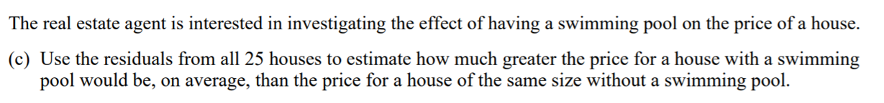
For this question, take the average of the residuals for the 8 properties that had a pool. Type in L1: Mean residual is 18.625 (1000’s).
Then take the average of residuals of properties that do not have a pool. Mean residual is – 8.8235.
These residuals indicate that the regression line is under estimating properties with a pool by an average value of $18,625. In contrast, it is also overestimating properties with no pool by an average value of $8823.5 .
The difference in the residual is: 27.4485 (1000’s). This suggests that properties with pools would likely cost $27,448.5 more than a properties of the same size.

Slide 38
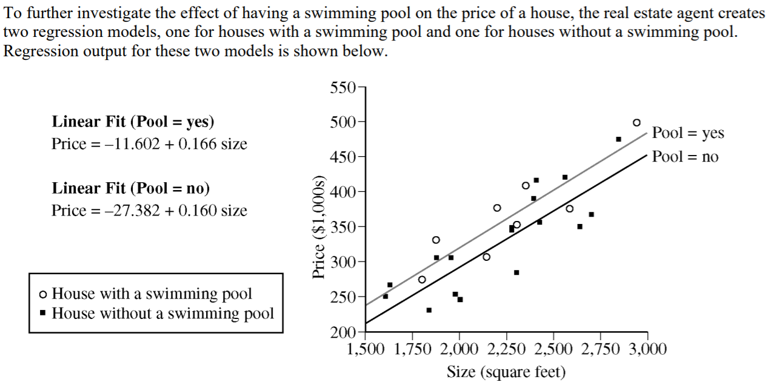

Since the confidence interval contains 0, it would suggest that there is no significance difference in the two slopes.
Use the two regression lines to calculate the predicted property values for a size of 2000sqft, 2500 sqft, and 2250 sqft. (pick one or all, up to you) Choose these values because they are near the middle of most data points.

Slide 39

The price of a property with a pool and size 2000 sqft would be 320.398 (1000’s). The price of a property with no pool and size 2000 sqft would be 292.618 (1000’s).
The difference in value is around 27.78 (1000’s). This value is very close to the difference in average residuals between the two types of properties.

